Slide 1





Predictive analytics S&P 500 sector returns vs economic indicators
Holly shirmenzagas, Daniel Jackson, Nathan palmer, Daniel ”DC” Carrillo

Slide 2

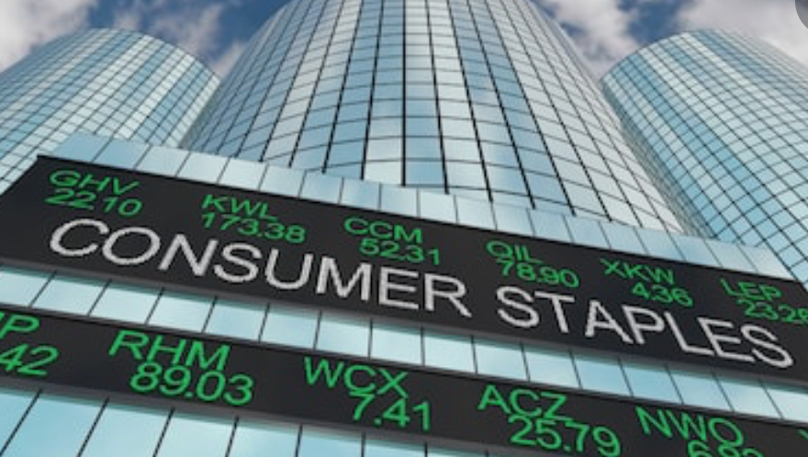


We looked at s&p 500 sector data
Consumer Discretionary Consumer Staples Energy Financial Health Industrial Energy Materials Technology Utilities

Slide 3




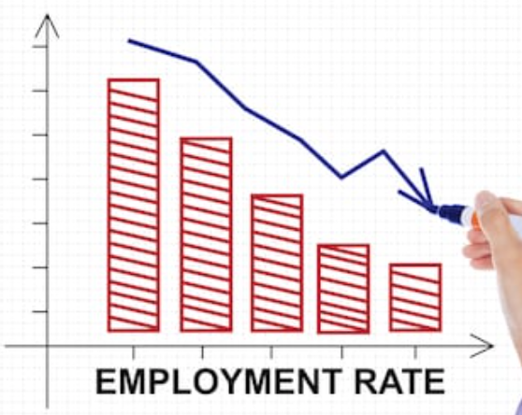
We looked at specific economic indicators
Typical Economic Indicators Unemployment Import/Export Index Consumer Price Index Producer Price Index
Atypical Economic Indicators Cardboard pricing Superbowl AFC/NFC Beer pricing Cosmetics prices Crime scene investigation Underwear prices Haircut pricing

Slide 4
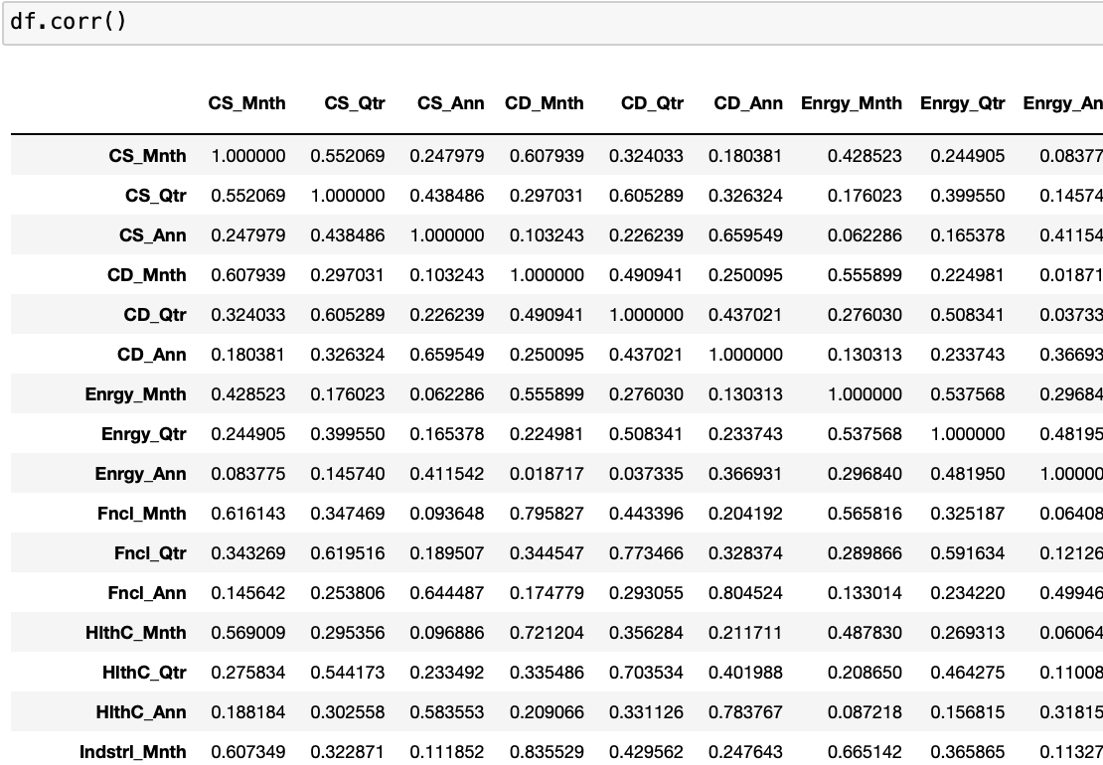
Initial linear regression models
We used a very simple approach for initial visualizations of the data with linear regression
We specifically observed correlations of our data sets as a cursory overview

Slide 5
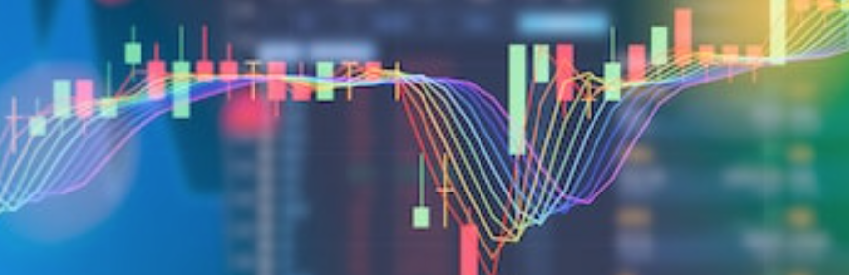
Empowered Predictive analysis with sklearn

Slide 6
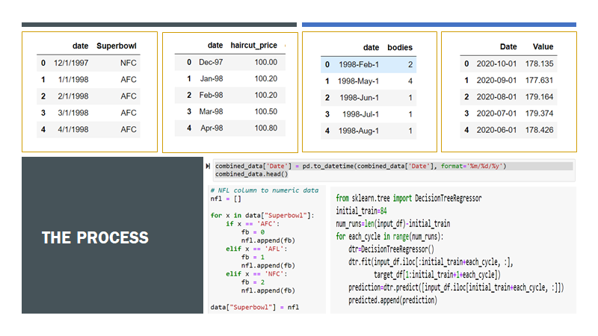
The process

Slide 7
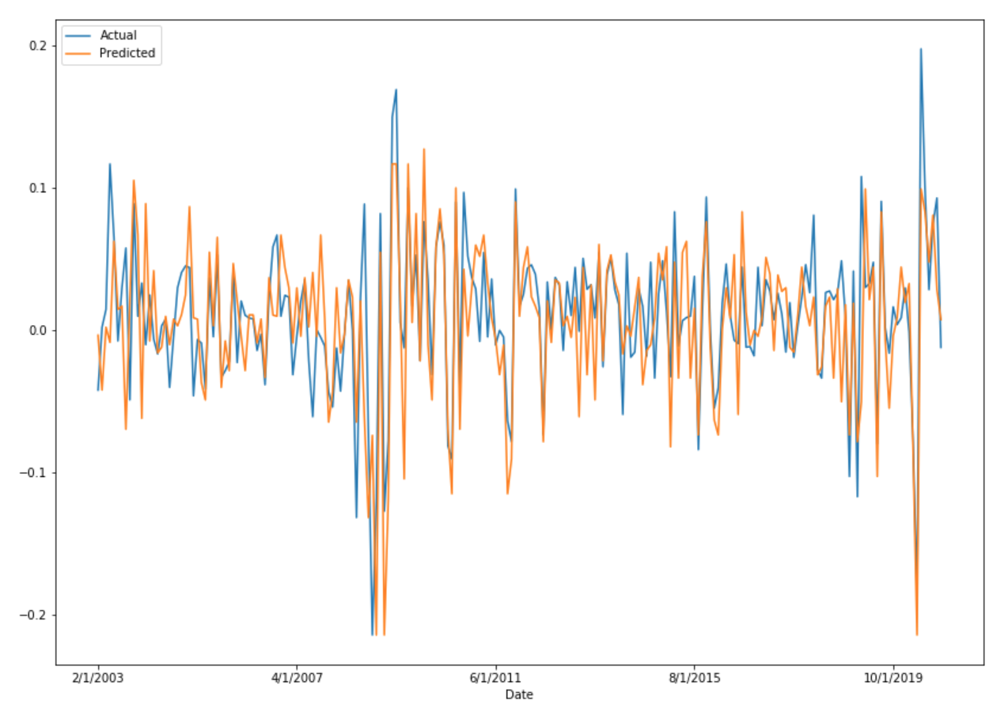
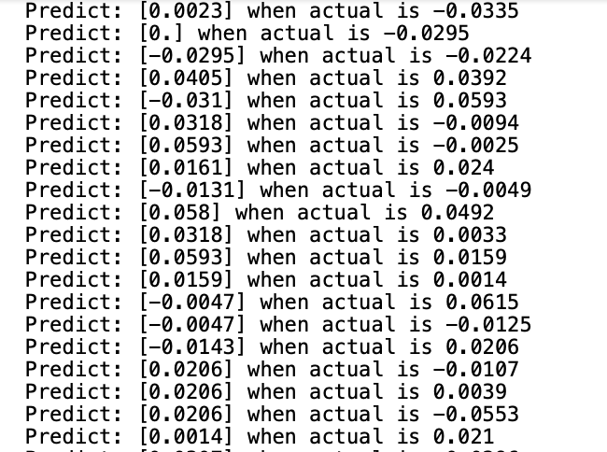
Algorithm & backtesting
Predictive data generated with Sklearn
Predictive data visualized with Matplotlib

Slide 8

Tableau visualizations

Slide 9
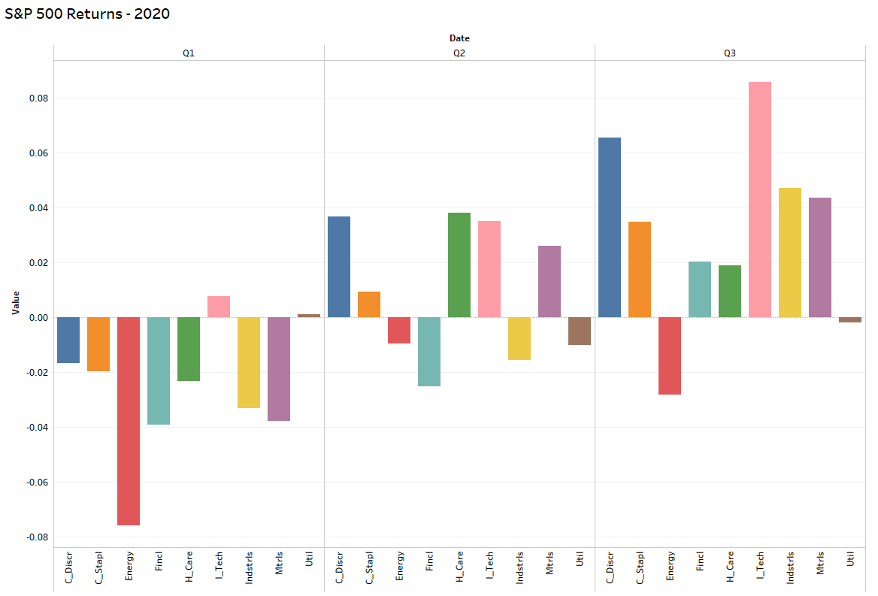
S&P 500 Returns - First three quarters of 2020
You can see the sectors in the market take a turn for the better beginning in Q2 as the US recovered from the COVID-19 lockdowns.
Energy is Red
Tech is Pink

Slide 10
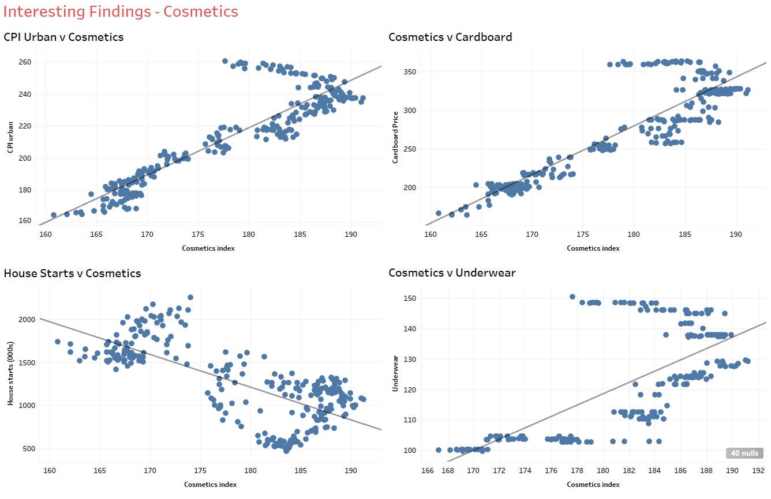
Interesting findings - cosmetics
The independent variables were not only mostly correlated to one another, there was a clear relationship with some of the more traditional indices like the Consumer Price Index and Housing Starts

Slide 11

HTML Development

Slide 12

HTML Discussion
*Insert short talking points, if necessary, on Holly’s work to develop the website*

Slide 13

to be continued…

